Slide 1
Final Project using SQL
Name – Chaitanya Deshpande
Batch – 12th May 2025
Course – Data Science

Slide 2
Project Title : Sales Performance Analysis of Walmart Stores Using Advanced MySQL Techniques
Objective: Analyze the Walmart Sales Dataset to segment customers based on spending, enabling targeted marketing, improved inventory management, and enhanced customer relationship strategies for increased profitability.

Slide 3
List of Task
Task 1- Identifying the Top Branch by Sales Growth Rate.(4 – 5)
Task 2- Finding the Most Profitable Product Line for Each Branch.(6 -7 )
Task 3- Analyzing Customer Segmentation Based on Spending.(8-9 )
Task 4- Detecting Anomalies in Sales Transactions.(10-11 )
Task 5- Most Popular Payment Method by City.(12-13 )
Task 6- Monthly Sales Distribution by Gender.(14-15 )
Task 7- Best Product Line by Customer type.(16-17)
Task 8- Identifying Repeat Customers.(18-19 )
Task 9- Finding Top 5 Customers by Sales Volume.(20-21)
Task 10-Analyzing Sales Trends by Day of the Week.(22- 23)

Slide 4
Task 1 - : Identifying the Top Branch by Sales Growth Rate
SELECT Branch, AVG(GrowthRate) AS AvgGrowthRate
FROM ( SELECT Branch, DATE_FORMAT(Date, '%Y-%m') AS Month, SUM(Total) AS MonthlySales, (SUM(Total) - LAG(SUM(Total)) OVER (PARTITION BY Branch ORDER BY DATE_FORMAT(Date, '%Y-%m'))) / LAG(SUM(Total)) OVER (PARTITION BY Branch ORDER BY DATE_FORMAT(Date, '%Y-%m')) AS GrowthRate FROM sales
GROUP BY Branch, DATE_FORMAT(Date, '%Y-%m')) AS SalesGrowth
GROUP BY Branch
ORDER BY AvgGrowthRate DESC LIMIT 1;

Slide 5
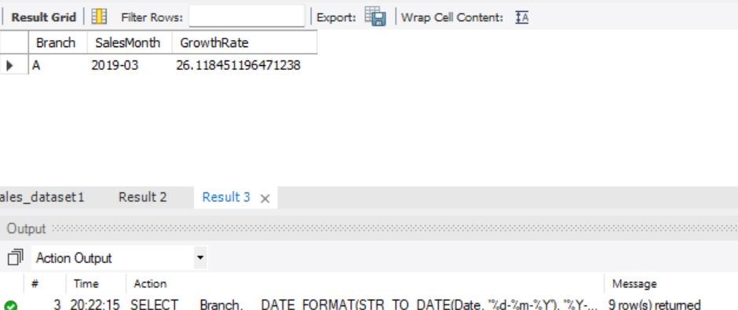
Output:-

Slide 6
Task 2: Finding the Most Profitable Product Line for Each Branch
SELECT Branch, `Product line`, SUM(`gross income`) AS TotalProfit FROM sales
GROUP BY Branch, `Product line`
ORDER BY Branch, TotalProfit DESC;

Slide 7
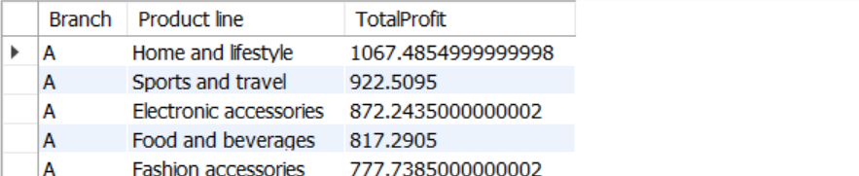
Output of task 2

Slide 8
Task 3: Analyzing Customer Segmentation Based on Spending.
SELECT `Customer ID`, AVG(Total) AS AvgSpending,
CASE
WHEN AVG(Total) >= 400 THEN 'High'
WHEN AVG(Total) BETWEEN 200 AND 399 THEN 'Medium'
ELSE 'Low'
END AS SpendingTier FROM sales
GROUP BY `Customer ID`;

Slide 9
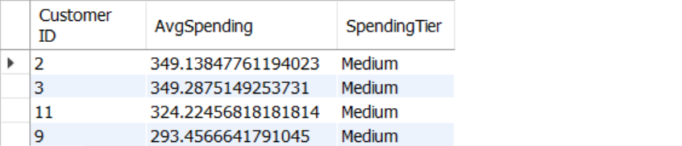
Output of task 3.

Slide 10
Task 4: Detecting Anomalies in Sales Transactions
SELECT * FROM sales s
JOIN ( SELECT `Product line`, AVG(Total) AS AvgTotal, STDDEV(Total) AS StdDevTotal FROM sales
GROUP BY `Product line`) stats
ON s.`Product line` = stats.`Product line`
WHERE ABS(s.Total - stats.AvgTotal) > 2 * stats.StdDevTotal;

Slide 11
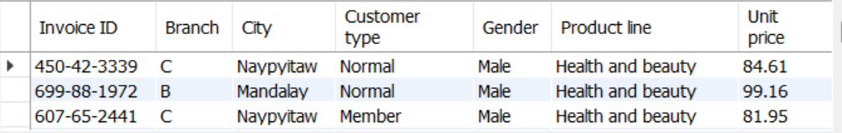
Output of task 4

Slide 12
Task 5: Most Popular Payment Method by City.
SELECT City, Payment, COUNT(*) AS UsageCount FROM sales
GROUP BY City, Payment
HAVING COUNT(*) = ( SELECT MAX(payment_count) FROM
( SELECT City AS c, Payment AS p, COUNT(*) AS payment_count FROM sales
GROUP BY City, Payment HAVING c = City )
AS inner_counts);

Slide 13

Output of task 5:

Slide 14
Task 6: Monthly Sales Distribution by Gender.
SELECT DATE_FORMAT(Date, '%Y-%m') AS Month, Gender, SUM(Total) AS MonthlySales FROM sales
GROUP BY Month, Gender
ORDER BY Month;

Slide 15
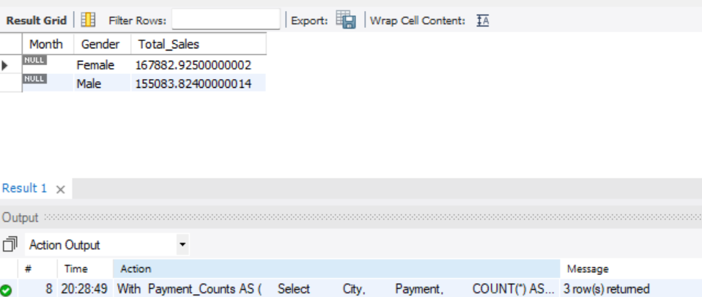
Output of task 6.

Slide 16
Task-7:- Best Product Line By Customer Type
SELECT `Customer type`, `Product line`, SUM(Total) AS TotalSales From sales
GROUP BY `Customer type`, `Product line`
ORDER BY `Customer type`, TotalSales DESC;

Slide 17
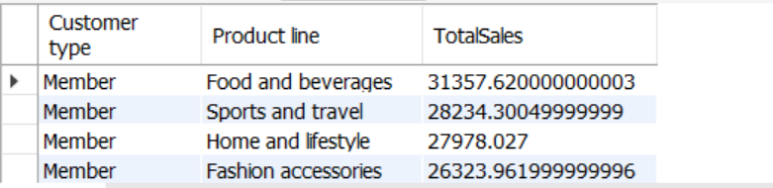
Output of task 7.

Slide 18
Task 8: Identifying Repeat Customers
SELECT DISTINCT a.`Customer ID`FROM sales a
JOIN sales b
ON a.`Customer ID` = b.`Customer ID`AND a.Date != b.Date
WHERE DATEDIFF(a.Date, b.Date) BETWEEN 1 AND 30;

Slide 19
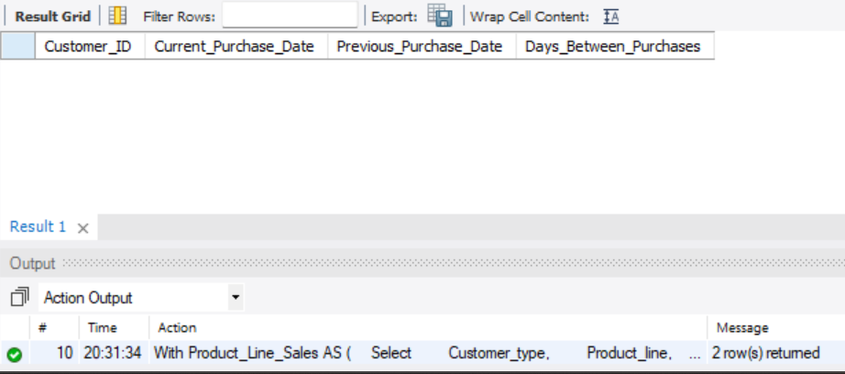
Output of task 8

Slide 20
Task 9: Finding Top 5 Customers by Sales Volume.
SELECT `Customer ID`, SUM(Total) AS TotalSpent FROM sales
GROUP BY `Customer ID`
ORDER BY TotalSpent DESC LIMIT 5;

Slide 21
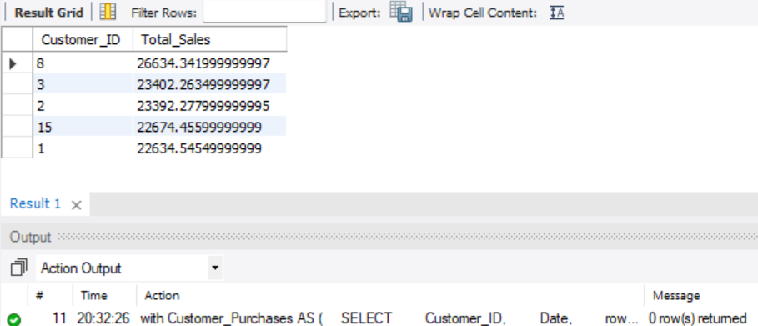
Output of task 9.

Slide 22
Task 10: Analyzing Sales Trends by Day of the Week.
SELECT DAYNAME(Date) AS DayOfWeek, SUM(Total) AS TotalSales FROM sales
GROUP BY DayOfWeek
ORDER BY TotalSales DESC;

Slide 23
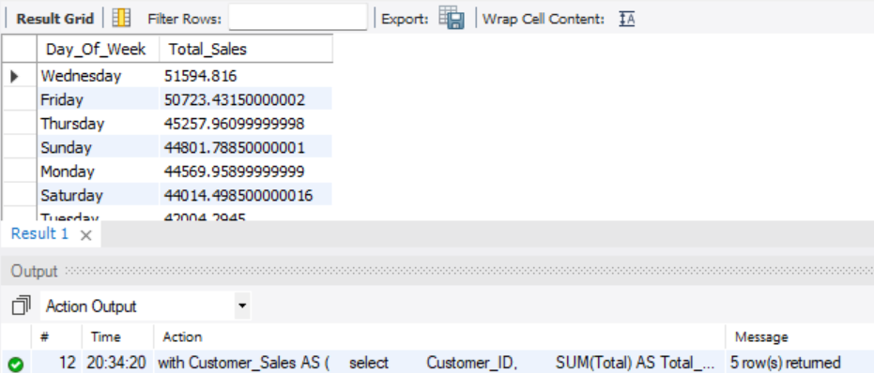
Output of task 10 .

Slide 24
Conclusion
The analysis of the Walmart Sales Dataset revealed key sales trends, customer preferences, and product performance across branches. It provided insights to enhance profitability, optimize inventory, and improve customer experience. Future steps could include deeper analysis for continuous improvement.

